Slide 1
Reinforcing Software Engineering Learning Through Provenance
Troy C. Kohwalter
Esteban W. G. Clua, Leonardo G. P. Murta
Instituto de Computação – Universidade Federal Fluminense (UFF)

Slide 2

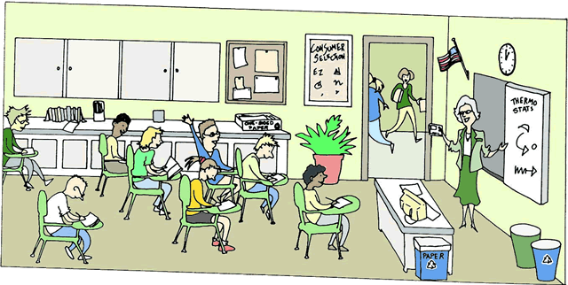
Motivation
Theoretical Classes
Knowledge
Practical Work
Competence
Know how to
Performance
Show how to
Notes:
Explain the motivation for using Serious Games

Slide 3

Motivation
Games
Fun
Enjoyment
Involving
Play
Motivating
Goals
Learning
Feedback
Notes:
Explain why Serious Games works

Slide 4
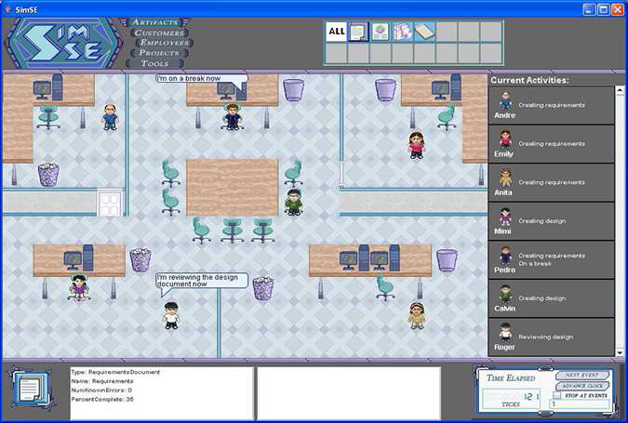
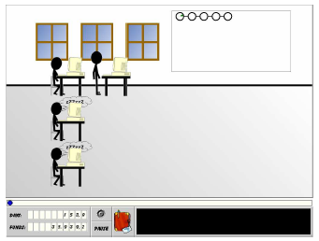
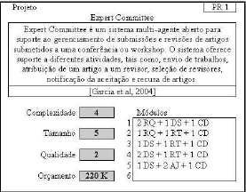
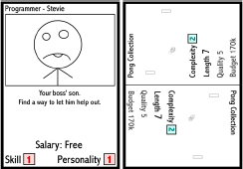
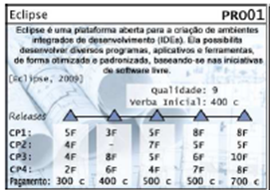
Serious Games Software Engineering
SIMSE
TIM
SIMULES
PnP
JEEES
Notes:
Examples of serious games for SE
Say about existing serious games for teaching Software Engineering

Slide 5


Motivation
Bloody Hell! Why did this happen!?
How!
Why!?
Impossible!!!
What have I done wrong?
Did I make a mistake?
How to analyze it?
Retry the game?
Watch a video?
Notes:
Explain the problem of analyzing the game outcome
Retrying a game N-times would consume too much time

Slide 6

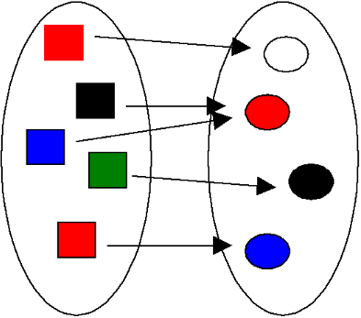
Previous Work
Provenance in Games
Conceptual Framework
Map Domains
Provenance to Games
Gather
Provenance Information
Causal Relationships
Notes:
In our previous work, we presented a conceptual framework called Provenance in Games, which maps elements from the provenance domain to games domain and also allows for gathering provenance information from a game session

Slide 7
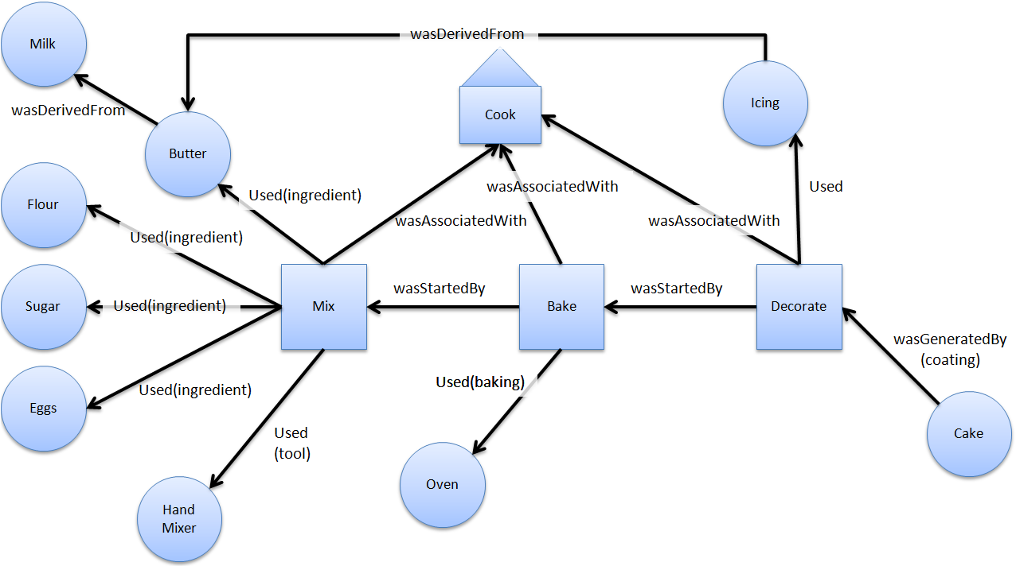
Provenance
“Refers to the documented history of an art object, or the documentation of processes in a digital object’s life cycle”
Notes:
Provenance
By its definition, Provenance refers to the documented history of an art object or the documentation of processes in a digital object’s life cycle
It uses a provenance graph to display the provenance information, which is a directed graph representing the causality relationships between the entities involved.
Cake graph example, showing vertex types and relationships

Slide 8

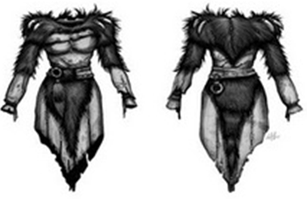



Provenance Gathering
Entity
Objects
Activity
Actions
Events
Agent
NPCs
Player
Notes:
This is the mapping from provenance to games.
Entities were mapped to inanimate game objects

Slide 9
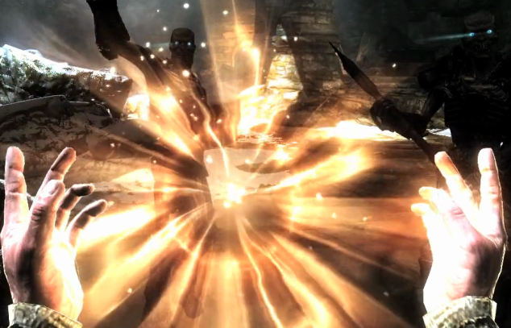


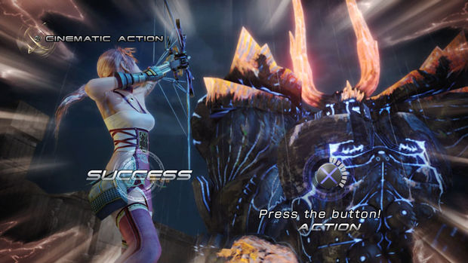
Provenance Gathering
Entity
Objects
Activity
Actions
Events
Agent
NPCs
Player
Notes:
Activities to actions and events

Slide 10

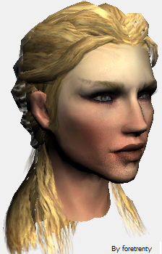


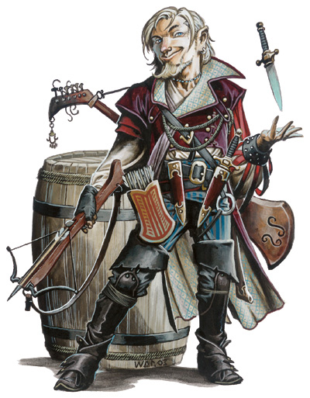


Provenance Gathering
Entity
Objects
Activity
Actions
Events
Agent
NPCs
Player
Notes:
And agents to game characters like NPCs and Players

Slide 11


Goal
Evaluate Game Provenance for:
Game Analysis
More efficient?
More effective?
Aiding Students
Understand underlying reasons
Notes:
The goal of this paper is to evaluate if the use of provenance during a game analysis aids students to understand the underlying reasons for the game outcome.
The goals of these experiments were to know if the provenance analysis is more efficient and effective than analyzing the game by re-watching the session, trying to observe if it has a higher identification rate of the cause-and-effect relations between the actions and their outcomes.

Slide 12
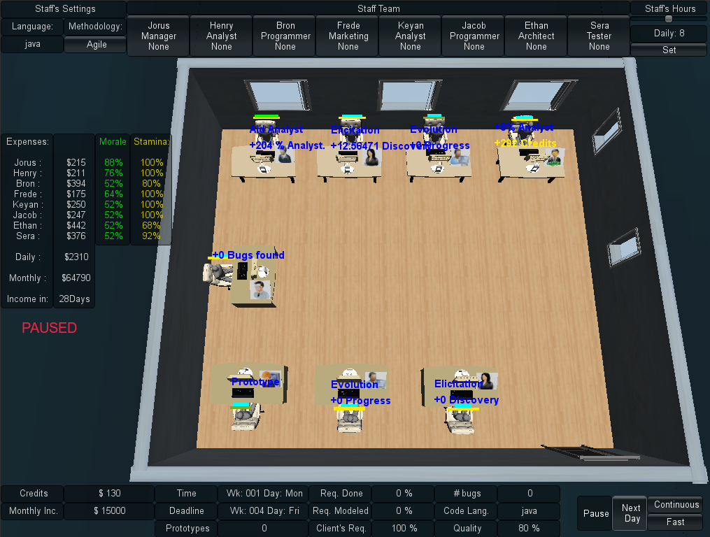
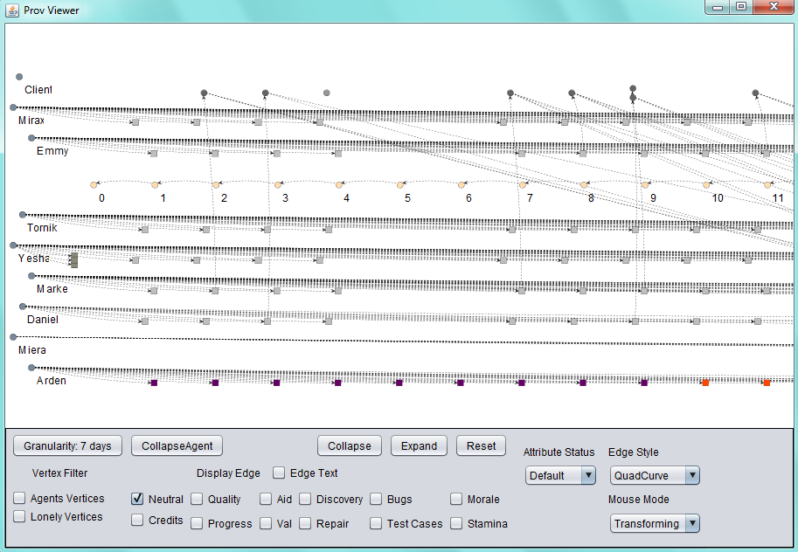
Case of Study
SDM: A Software Engineering Serious Game
Provenance Visualization
Prov Viewer

Slide 13
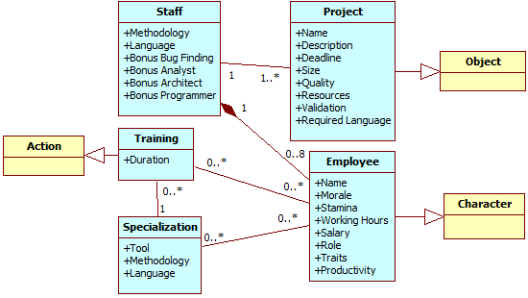
Case of Study
Notes:
SDM & Prov Gathering
Briefly explain SDM

Slide 14

Evaluation
Research Questions:
Provenance Analysis
Is faster than only watching a replay of the game session?
Is more accurate than only watching a replay of the game session?

Slide 15

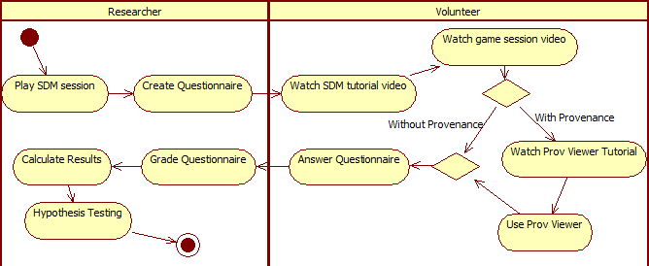
Experiment Plan
Notes:
Para avaliar a nossa abordagem, rodamos um experimento onde estudantes viam um vídeo referente a uma sessão de jogo e respondiam a perguntas quanto a esse jogo. Parte dos estudantes tinha acesso ao Prov Viewer e outra parte não. O intuito desse experimento era verificar o quanto a nossa abordagem auxilia no entendimento, em termos da precisão das respostas obtidas e da eficiência nessas respostas
Explicit say that we choose to use a game session video instead of playing the game due to time restraints and to make a more controlled experiment, otherwise the questionnaire would be too generic and would not be able to tell us if it indeed is better

Slide 16
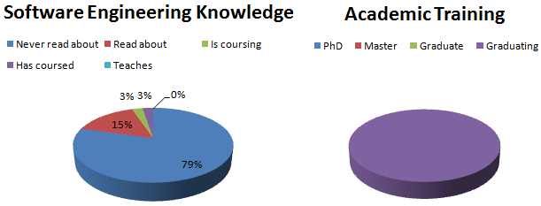
Experiment
37 Volunteers
5 dropped out
Notes:
Change Does Discipline

Slide 17

Questionnaire
Question 1 : Starting Time
Question 2: Experiment Group
Question 3: Reason for employee Arden quit his job
Lack of payment
Question 4: One reason for employee Daniel to quit his job
Lack of payment or Overworking
Question 5: Why employee Tornik made no progress during a period of time
Lack of prototypes to validate requirements
Question 6: Why Daniel’s productivity had a sudden drop
Negative influence from his manager
Question 7: Most contributing factor that allowed the software to finish in time
Negotiation for extended deadline
Question 8: The two most contributing factors that caused financial problems
Hiring and staff training
Question 9: Which employee was idle during a certain period of time
Arden
Question 10: End Time

Slide 18
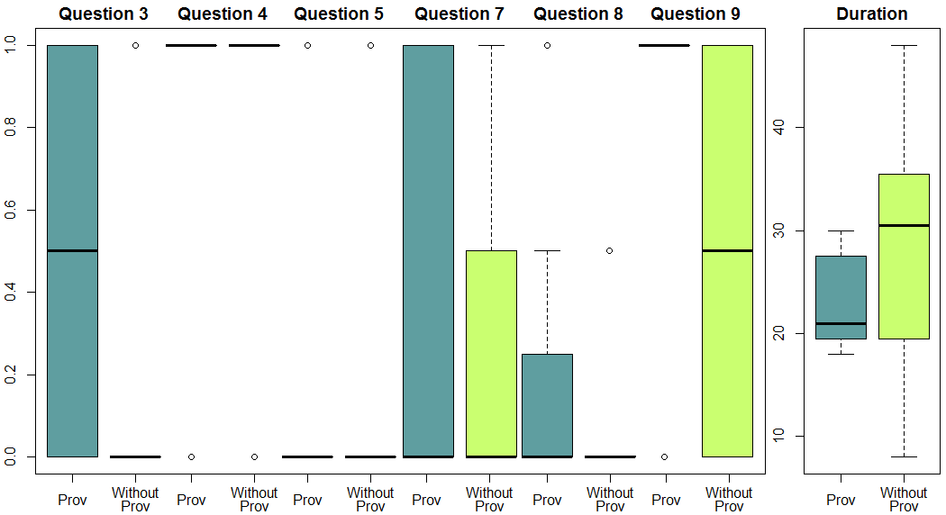
Experiment Results
 |  | Q3 | Q4 | Q5 | Q6 | Q7 | Q8 | Q9 | Duration
With Prov | Mean | 0.5 | 0.9375 | 0.1875 | 0 | 0.375 | 0.1562 | 0.8125 | 23.1875
 | Standard Deviation | 0.5164 | 0.25 | 0.4031 | 0 | 0.5 | 0.3010 | 0.4031 | 4.2461
Without Prov | Mean | 0.0625 | 0.875 | 0.1875 | 0 | 0.25 | 0.0938 | 0.5 | 28.9375
 | Standard Deviation | 0.25 | 0.3416 | 0.4031 | 0 | 0.4472 | 0.2015 | 0.5162 | 10.5797
Notes:
Falar o que os valores da tabela representa
Média das notas atribuídas a cada questão do questionário

Slide 19

Experiment Results
Mann-Whitney Test
H₀ : μ_{prov} = μ_{replay}
H₁ : μ_{prov} ≠ μ_{replay}
p-value < α: Reject null Hypothesis
α = 0.05 = 5%
α = 0.05 | Correctness |  |  |  |  |  |  | Time
 | Q3 | Q4 | Q5 | Q6 | Q7 | Q8 | Q9 | Duration
p-value | 0.007259 | 0.5757 | 1 | Null | 0.467 | 0.6371 | 0.07049 | 0.03595
Notes:
We used non-parametric tests because the results were not following a normal distribution

Slide 20

Result Analysis
Null hypothesis Rejected
Question 3
Questionnaire duration
Values from both groups are not statistically equal
Provenance Group had better answer and is faster
Question 9 almost rejected (0.07 ~ 0.05)
Provenance Group had better results but were not statistically significant
Other questions
Not statistically significant

Slide 21

Threats to Validity
Internal
Group Division
Random
Individual Perception
Volunteers are more motivated
First Contact with Game and Tool
External
Discrepancy in Experience
Mitigated by being in the same semester and class
Construct
Lack of Knowledge
Mitigated by having 7 Questions exploring different aspects
Duration
Mitigated by controlling start and end time
Conclusion
Interpretation
Mitigated by explaining Questionnaire
Watched a video instead of playing
Notes:
Ameaças Concretas do experimento

Slide 22

Conclusion
Presented new perspectives on Software Engineering learning process
Game provenance
Induce deeper analysis
Induce discussions regarding the game session
Identify Cause-and-Effect Relationships
Game Provenance can also help on:
Confirming the hypotheses formulated by students
Supporting tutors for a better guidance
Motivating practical exercises around some case studies
Extracting behavior patterns from individual sessions or groups of sessions

Slide 23


Research Questions
Provenance Analysis
Is faster than only watching a replay of the game session?
Yes, even when using the tool for the first time
Is more accurate than only watching a replay of the game session?
Yes. It provided equal or more accurate answers in at least one case

Slide 24


Future Work
Graph
Layouts
Inference
Game module for Provenance Gathering
Easier integration with other games
More Experiments!

Slide 25
Reinforcing Software Engineering Learning Through Provenance
Troy C. Kohwalter
Esteban W. G. Clua, Leonardo G. P. Murta
Instituto de Computação – Universidade Federal Fluminense (UFF)

